Slide 1

University of Puerto Rico in Humacao
Rocío Del Mar Negrón
Glarimar Rodriguez
Laiza Arce Cruz
INGL 0080
Dr. Jesus Lopez

Slide 2
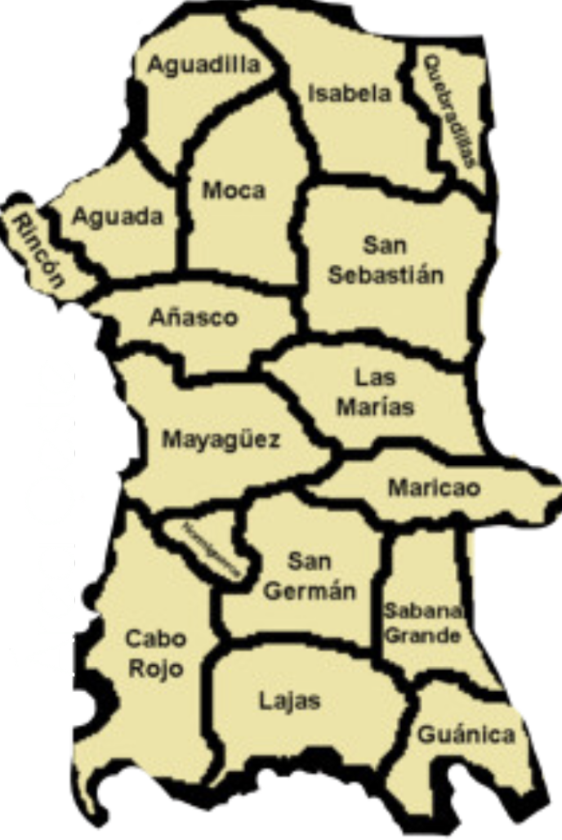
Location:
Arcadia
https://www.banderasboricuas.com/banderas-municipales/

Slide 3

Flag:

Slide 4

Language:
https://www.salesforce.com/ca/blog/2016/10/sales-language-affects-bottom-line.html

Slide 5

Population:
https://healthitanalytics.com/features/what-are-the-social-determinants-of-population-health

Slide 6

Religion:
https://www.bbc.com/news/uk-scotland-41294688

Slide 7

Political system:
https://www.nacion.com/opinion/foros/una-propuesta-para-un-nuevo-sistema-politico/MLUD6POX7VHK3OBPACK7IIUTXU/story/

Slide 8

Education:
https://www.forbes.com/sites/enriquedans/2018/03/09/why-textbooks-and-education-are-to-blame-for-fake-news/#55e2b3bb42e9

Slide 9

Immigration policy:
https://medium.com/@jstooksberry/why-conservatives-should-support-liberal-immigration-policies-c11f81c47f7

Slide 10

Portation of arms:
https://aldia.microjuris.com/2018/02/19/historiadores-militares-y-veteranos-se-expresan-en-segunda-audiencia-publica-sobre-nueva-ley-de-armas/

Slide 11
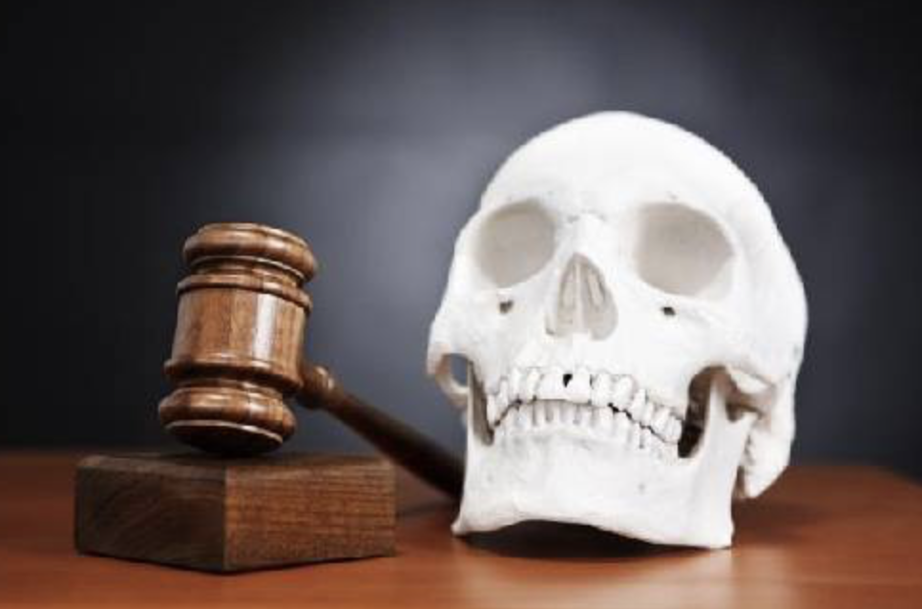
Death penalty:
https://www.caracteristicass.de/pena-de-muerte/

Slide 12

Get marry:
https://www.brides.com/story/chiara-ferragni-wedding-photos

Slide 13

Industries:
https://www.klika.mx/industrias-mas-contaminantes-medio-ambiente/

Slide 14

SDGS: No Poverty
http://in.one.un.org/page/sustainable-development-goals/sdg-1/

Slide 15

SDGS: Clean water and sanitation
http://in.one.un.org/page/sustainable-development-goals/sdg-6/

Slide 16

SDGS: Good health and well-being:
https://www.youtube.com/watch?v=0klcaICeJA4

Slide 17

SDGS: Gender Equality:
https://www.ndtv.com/world-news/british-men-are-bigger-supporters-of-gender-equality-than-women-survey-1264359

Slide 18

SDGS: Quality Education:
http://www.in.undp.org/content/india/en/home/post-2015/sdg-overview/goal-4.html

Slide 19

SDGS: Climate Action:
https://in.one.un.org/page/sustainable-development-goals/sdg-13/

Slide 20

Conclusion:
https://www.oxbridgeessays.com/blog/how-to-conclude-your-essay-well/

Slide 21


